Slide 1
Linux Programming
18.01.2015

Slide 2
Schedule
Lection
Lab
Meet and greet
Introduction to course
Introduction to Linux
Virtual machines
Terminal
Makefiles
Setup Linux VM
Try basic commands in terminal
Write C code in Linux
Prepare makefile
Compile und Run

Slide 3

About the lecture
Martin Kuvandzhiev
Age 21
Born in Burgas
High school of mechanics and electronics
Technical University of Sofia
Working for TAO-Wellness
Creator of Project Valkyrie

Slide 4
Introduction to corse
What we gonna do ?

Slide 5
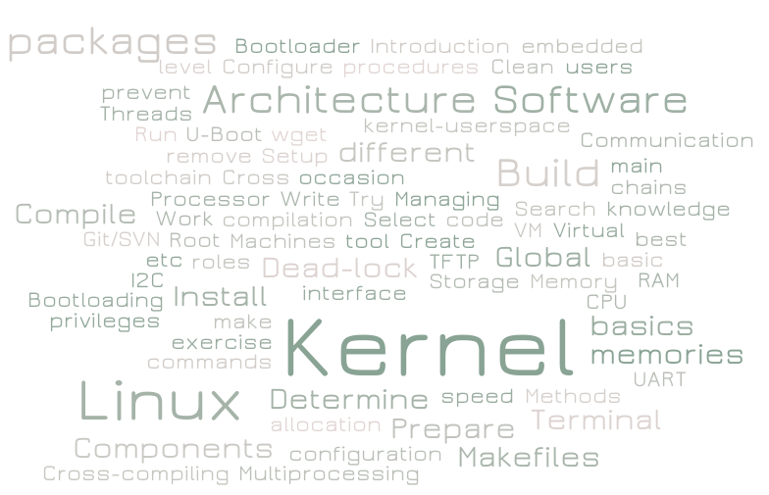

Slide 6
Requirements
C and Cpp programming basics
Laptop/Mac
Virtual Machine Client (VMware, VirtualBox etc.)
Imagination

Slide 7
What you are going to learn
What is Linux and how to use it
Work with Makefiles
Work with VM
Work with Terminal
Work withThreads
Work with Kernel
Filesystems
Git/SVN

Slide 8
Evaluation
Evaluation
20 % Homework
30 % Exam theory
50 % Exam practical tasks

Slide 9
Homework Evaluation
50% is based on the solution of the homework
Homework must be submitted before the deadline
Homework are evaluated by people who has sent their own homework
50% is based on evaluating other people’s homework
There will be a deadline for the evaluation
After evaluation of the homework a feedback

Slide 10
Exam theory
100% Test
No open answers
Single and multiple choice

Slide 11
Exam practical task
Setup a new virtual machine on PC
One kernal task
One C task
Makefiles for compilation
Commit to Git

Slide 12
Introduction to Linux
What the **** is Linux

Slide 13
Timeline
1983
GNU Project, free software concept by Richard Stallman
1991
Linux kernel project, a Unix-like os kernel by Linus Torvalds
Open - source
1995
development of gcc, gdb, glibc and other important tools
2000
Linux is more and more popular on embedded systems
2008
Linux is more and more popular on mobile devices
2010
Linux is more and more popular on phones
Linux is more and more popular on server systems

Slide 14
Examples of embedded Linux devices

Slide 15
Devices suitable for embedded development and prototyping
Raspberry Pi
Banana Pi
Olimex devices
Beagle bone
PCDuino
Other

Slide 16
Linux vs Windows
Criteria | Linux | Windows
Manufacturer | Linux kernel – open source, crow developed | Microsoft
Development | Open source, crowd developed, distributed by various vendors
Usage | Mobile phones, game consoles to mainframe supercomputers | Desktop computers, laptops, servers, mobile phones, tablets
File System support | Ext2, Ext3, Ext4, Jfs, Xfs, FAT, FAT32, NTFS, HFS+ | FAT, FAT32, NTFS, exFAT
Software | Packages | Installation archives

Slide 17
Linux Shell

Slide 18
Куешчънс???
VAPROSI ??

Slide 19
Virtual Machine
How to work with VM

Slide 20
Virtual Machine Clients
VMware
VirtualBox
Parallel desktop
Google Cloud Platform

Slide 21
Purpose of VM
Try different OS
Development of OS modules
QA software on different OS
Not to risk you data if you make a mistake

Slide 22
How does it work
Resource allocation
Easy to change hardware configuration
Performance problems

Slide 23
How to setup
Install a VM client
Download .img (.iso) of the OS you want to install
For Linux (minimum requirements)
5 GB space
1(2) cores
1 GB RAM

Slide 24
Questions ?

Slide 25
Setup a VM Linux Machine
Task 1 – 30 min

Slide 26
First steps in Linux (Debian)
Welcome to the world of infinite learning

Slide 27
Linux users
Standard user
Can read, write personal folders
Can read, write personal files
Can use user files installed on the systems
Administrators (sudoers)
Can do anything that a standard user can do
Install new packages
Set the system
Register, edit users

Slide 28
Linux users
Root user
God of the OS

Slide 29
Basic commands in Linux
cd – change directory (cd .. to return to previous level)
ls – list files
mkdir – make directory
rmdir – remove direcotry
nano – text redactor (like notepad)

Slide 30
Questions ?

Slide 31
Task 2 – 5 min
Start the VM Linux Machine
Login
Open directory “/”
What do you see there ?
Then open /home/your_user_name/
Create directory “test_directory”
Delete the directory “test_directory”
Create directory “hello_softuni”
Enter “hello_softuni”

Slide 32
How to use nano
$nano filename.extention will open (or create) a file with this name
$nano path/to/file/filename.extention will open(or create) a file with this name on the path/to/file directory
Use ^X to exit the file. You might be asked to save it after you press ctrl(^) + X.

Slide 33
Questions ?

Slide 34
Task 3 – 10 min
Make a new file called “main.c” in hello_softuni folder
Inside the file write a “hello softuni” program.
Save and Exit the file

Slide 35
Compiling a simple .c file
How to do it without a button

Slide 36
What is to compile a code
Translate a code from .c (or other language) to object code (which is understandable by machine) and an executable file.
In linux is recommended to recompile the code for new machines
You are using GCC (GNU Compiler Collection) to compile on Linux. It is supporting all of cpp like languages

Slide 37
How to compile and run on Linux
$gcc path/to/file/inputFile.c –o path/to/file/outputFile
$./path/to/file/outputFile

Slide 38
Questions ?

Slide 39
Task 4 – 5 min
Compile hello_softuni.c
Run hello_softuni

Slide 40
Makefiles

Slide 41
Makefile
In order to compile easily multiple files, or to follow a specific pattern of compiling there are makefile file on Linux
With using the simple command “$make” linux understands that it should start the makefile script

Slide 42
Makefile composition
target: dependencies
[tab] system command

Slide 43
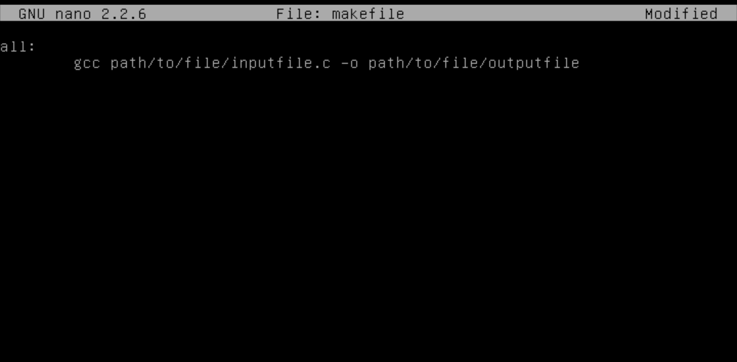
Makefile example

Slide 44
Questions ?

Slide 45
Task 5 – 10 min
Compile hello_softuni with a makefile
Execute make command
Execute output file

Slide 46
Daily Final Task – 30 min
Write a C program that calculates
Speed by given Acceleration and time after the start of the acceleration (Easy)
Distance by given Acceleration and time after the start of the acceleration (Medium)
Time to stop if the car has deceleration equal to Acceleration divided by 2, by given time and Distance (Hard)
Create a makefile
Compile and run

Slide 47
Data for the task
For 1 and 2
Acceleration = 10 meters per second
Time = 2 minutes
For 3
Distance is 12100 m
Time is 110 s

